Slide 1
Car Price Prediction using Machine Learning
By : Mrs. Swati Amit Motugade

Slide 2
Overview
Introduction to Car Market
Problem Statement
Data Collection
Data pre-processing
EDA
Feature Engineering
ML Model Building
Conclusions on Predictions

Slide 3
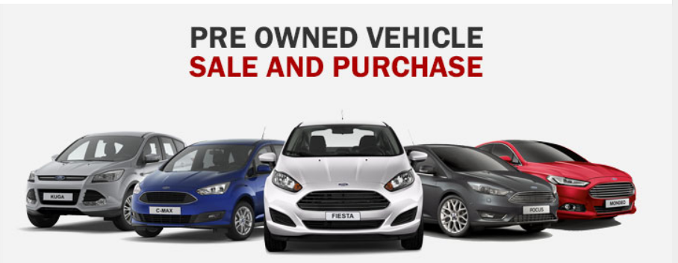
Introduction
The price of a new car in the industry is fixed by the manufacturer with some additional costs incurred by the Government in the form of taxes. So, customers buying a brand-new vehicle may be confident of the money they make investments to be worth. But, due to the increased prices of new cars and the financial incapability of the customers to buy them, used Car sales are on a global increase. Even as new car sales have slowed down in the recent past, the pre-owned car market has continued to grow over the past year and is larger than the new car market now.

Slide 4
Introduction
Consider this: In 2018-19, while new car sales were recorded at 3.6 million units, 4 million second-hand cars were bought and sold, according to a recent report on India’s pre-owned car market by Indian Bluebook, a used car pricing guide by Mahindra First Choice Wheels.
The growth rate of new car sales has slowed owing to a variety of reasons, including cyclical slowdown in auto sales in election years and an overall consumption slowdown in the economy. New car sales grew 2.70% in 2018-19, the slowest growth rate for the industry in four years. In April, passenger vehicle sales saw a sharp decline compared with the same month last year, and domestic sales saw a contraction of 17.07%.

Slide 5
Problem Statement
Task1 :
To scrape the data of used cars from websites (Olx, cardekho, Cars24 etc.) using web scraping .
Task2 :
To build a machine learning model.
Before model building do all data pre-processing steps. Try different models with different hyperparameters and select the best model.

Slide 6
Data Collection
Here, web scraping with Beautiful Soup is used to extract data.
The data is collected from car.com website which is one of the top cars selling site. The front display page of this site provides the information about preowned cars which are posted for sale. The information contains the factors Car Model, make year, Dealer Name, Mileage or Kilometres driven, Condition of car, Customers Ratings, Total count of Reviews and Price.
The company asked to collect the data for more than 5000 cars. Here we have collected the data for 6000 cars. To get this number we scrapped 300 pages of the website.

Slide 7
Data Cleaning
Since we extracted the raw data we cannot directly use it for analysis. The data needs cleaning as it contains some error.
Hence the cleaning part should be like :
The features Price, Reviews are the numbers separated by ‘,’ because of which their datatypes are showing as object datatype. So we have to remove these commas.
Since the prices are in Dollars the feature has Dollar sign ‘$’ which we have to remove.
Also the feature Mileage has ‘mi’ next to the actual mileage number which we need to remove.
The vehicle name and its make-year are in one string. So we need to separate them.

Slide 8
Data Cleaning
The above required data cleaning is done with the below codes and got the final dataset in the csv file format

Slide 9
Dataset Information
Below are the variables after cleaning the extracted data.
Dealer :- Name of the dealer
Car_model :- Model of vehicle
Make_year :- year of manufacture of the vehicle
Mileage :- The number of kilometres driven before
Ratings :- ratings given by customers
Reviews :- total number of reviews
Price :- price of car in dollars

Slide 10
Data Pre-processing
Out of all 8 features only three features with numerical and rest are categorical features.
Data integrity check is perform for missing values, duplicate data, data error.
Since, there are ‘N/A’ values present in our dataset we replaced them by np.NaN.
The missing values are present in the features ‘Ratings’ and ‘Reviews’.
The missing value imputation is made by using the mode imputation for ‘Ratings’ and mean imputation for ‘Reviews’.

Slide 11
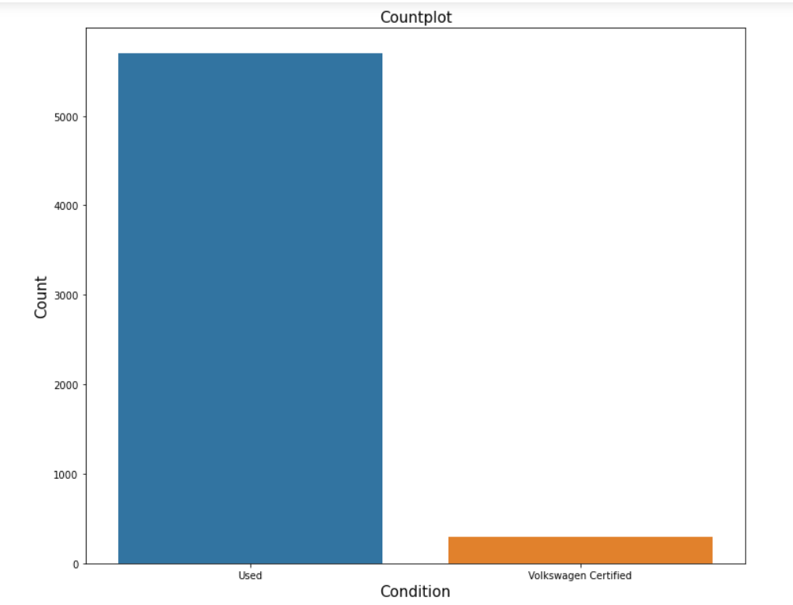
EDA
Condition :
Out of all 6000 cars, 5700 are used cars.
The remaining 300 cars are Volkswagen certified cars.

Slide 12
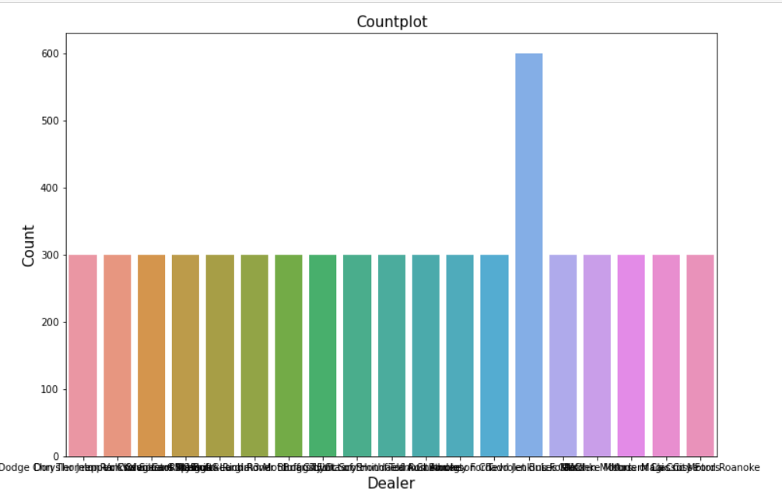
EDA
Dealer :
The dealer Tadd Jenkins ford has maximum number of cars i.e. 600 for sale.
The remaining cars are equally distributed over rest of the dealers i.e. rest of the dealers has equal number of cars i.e. 300 for sale

Slide 13
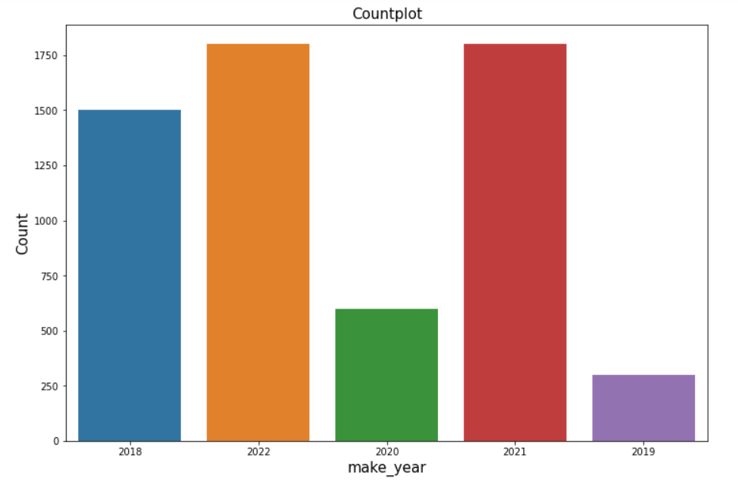
EDA
make_year :
Maximum cars for sale are of make_year 2021 followed by 2022.
There are less number of cars for sale which are manufactured in 2019.

Slide 14
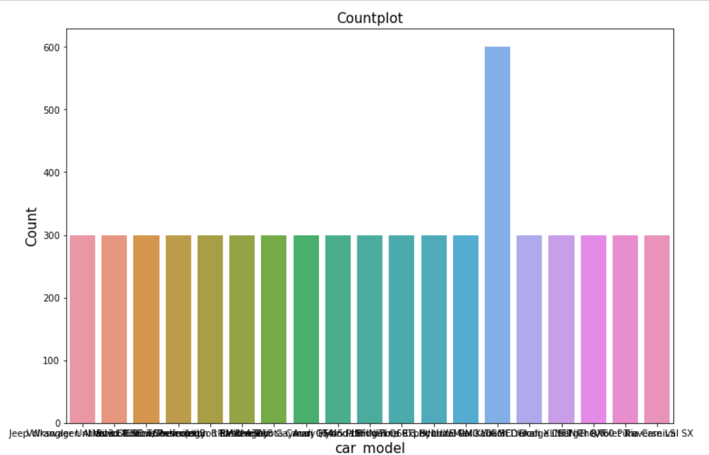
EDA
Car model :
There are total 19 car models for sale on site which are GNC Yukon Denali, Audi, Toyota, BMW, Hyundai, Ford, Honda, Volkswagen, Chevrolet, Volvo, Kia, INFINITI, Dodge, Porsche, Jeep etc. 600 cars are of GNC Yukon Denali model and remaining are of other models mentioned above with equal number.

Slide 15
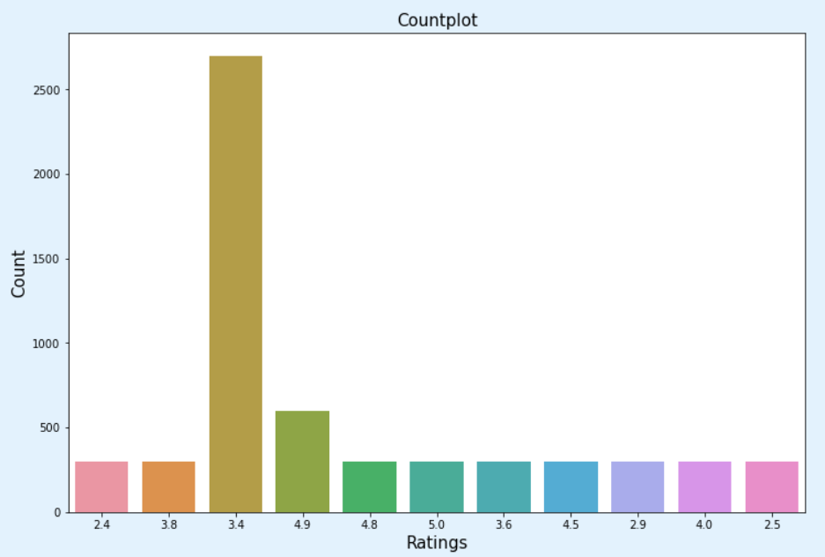
EDA
Ratings :
3.4 is the most common rating given by customers for the vehicles followed by the rating 4.9

Slide 16
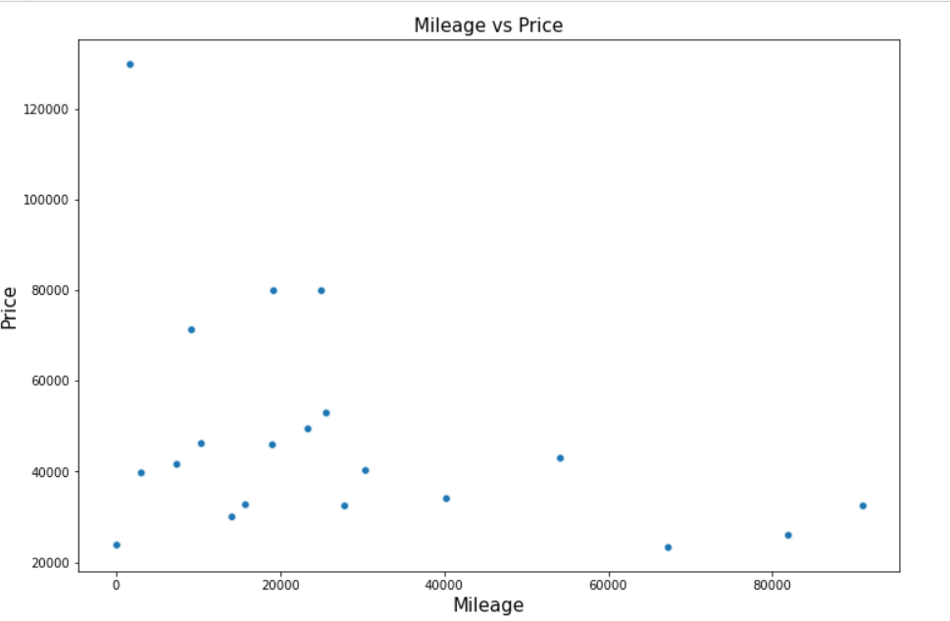
EDA
Mileage
Here, the scatterplot shows that there is a negative correlation between mileage and price of the car. It means that as the mileage i.e. kilometres driven increases the price of the vehicle decreases.

Slide 17
Feature Engineering Outliers detection & removal
Outliers exists in only upper bound of the feature and not in lower bound.
So we used the Quantile based Flooring-Capping method to remove outliers.
Flooring is performed at 0th percentile for lower bound and capping perform at 95th percentile for upper bound.
Data loss while removing outliers is 10%.

Slide 18
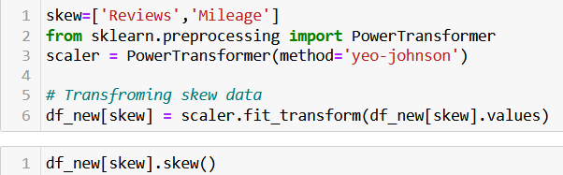
Skewness
Considerable amount of skewness exist in two features ‘Reviews’ and ‘Mileage’.
Yeo-Johnson Power Transformation used to reduce skewness.

Slide 19
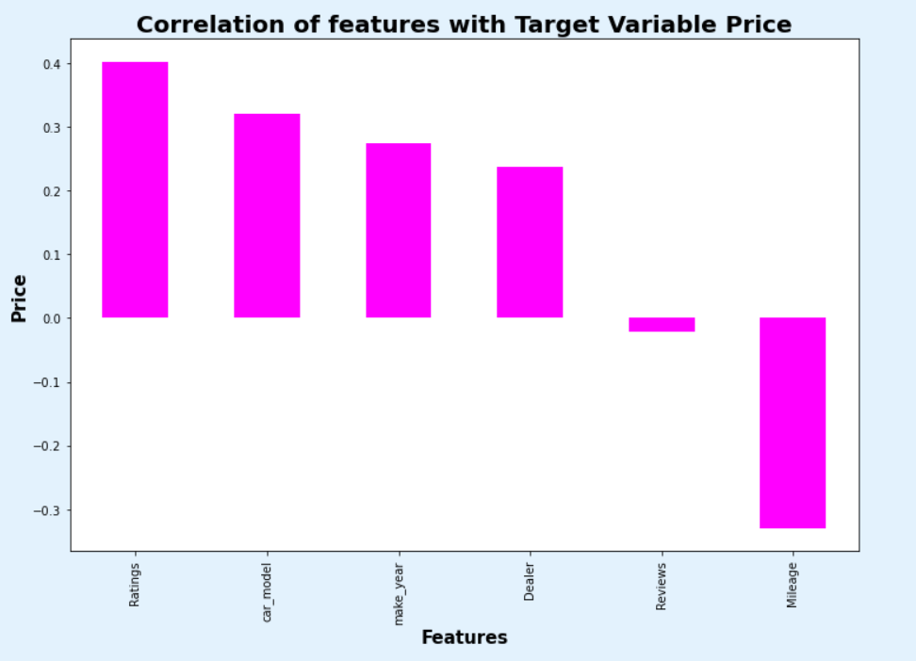
Correlation
Positively correlated features are Ratings, car_model, make_year, dealer, Reviews.
Only the feature Mileage is negatively correlated.
The highest correlated feature is Ratings.

Slide 20
Model Building
Our objective is to predict the price of used cars. It can be solved by application of regression ML algorithm.
Different regression algorithm used to train model, in order to have maximum R2 score.
Machine learning regression algorithms used in this project are –
Linear Regression
Decision Tree Regressor
Random Forest Regressor
K-Neighbours Regressor
AdaBoost Regressor

Slide 21
Model Evaluation Summary
ML Algorithm | R2 Score | CV Score
Linear Regression | 0.557493 | 0.519344
Random Forest Regressor | 1.0 | 1.0
Decision Tree Regressor | 1.0 | 1.0
K-Neighbours Regressor | 1.0 | 1.0
Extra Tree Classifier | 0.935749 | 0.943825
Among all the algorithms used Random Forest Regressor, Decision Tree Regressor and K-Neighbours Regressor gives us better R2 Score with zero Root Mean Squared Error.
Out of these 3 we will select Random Forest Regressor as final model and perform Hyperparameter optimization for this model

Slide 22
Hyperparameter Optimization
Since, Random Forest Classifier gives us best accuracy score with minimum difference between accuracy score and cross validation score, we select Random forest classifier as our final model and performed hyperparameter optimization with this model.
The accuracy score after hyperparameter optimization is 0.982.

Slide 23


